Slide 1
ECE 532
CHAPTER 3: TREES (PART 1:INTRODUCTION INTO TREES)
Lecturer: Dr. Roslina Mohamad
Room: Tower 2, Level 13, No:14C

Slide 2
Learning Outcomes
At the end of this lecture, you will be able to:
Learn about trees and trees terminology
Learn about trees representation
Learn the relationship between linked structures and trees
Explore the applications of trees

Slide 3
Introduction
So far we have seen linear data structures
• linear: before and after relationship
• lists, vectors, arrays, stacks, queues
No n-linear structure: trees
• probably the most fundamental structure in computing
• hierarchical structure
• Terminology: fro m family tree s (genealogy)

Slide 4
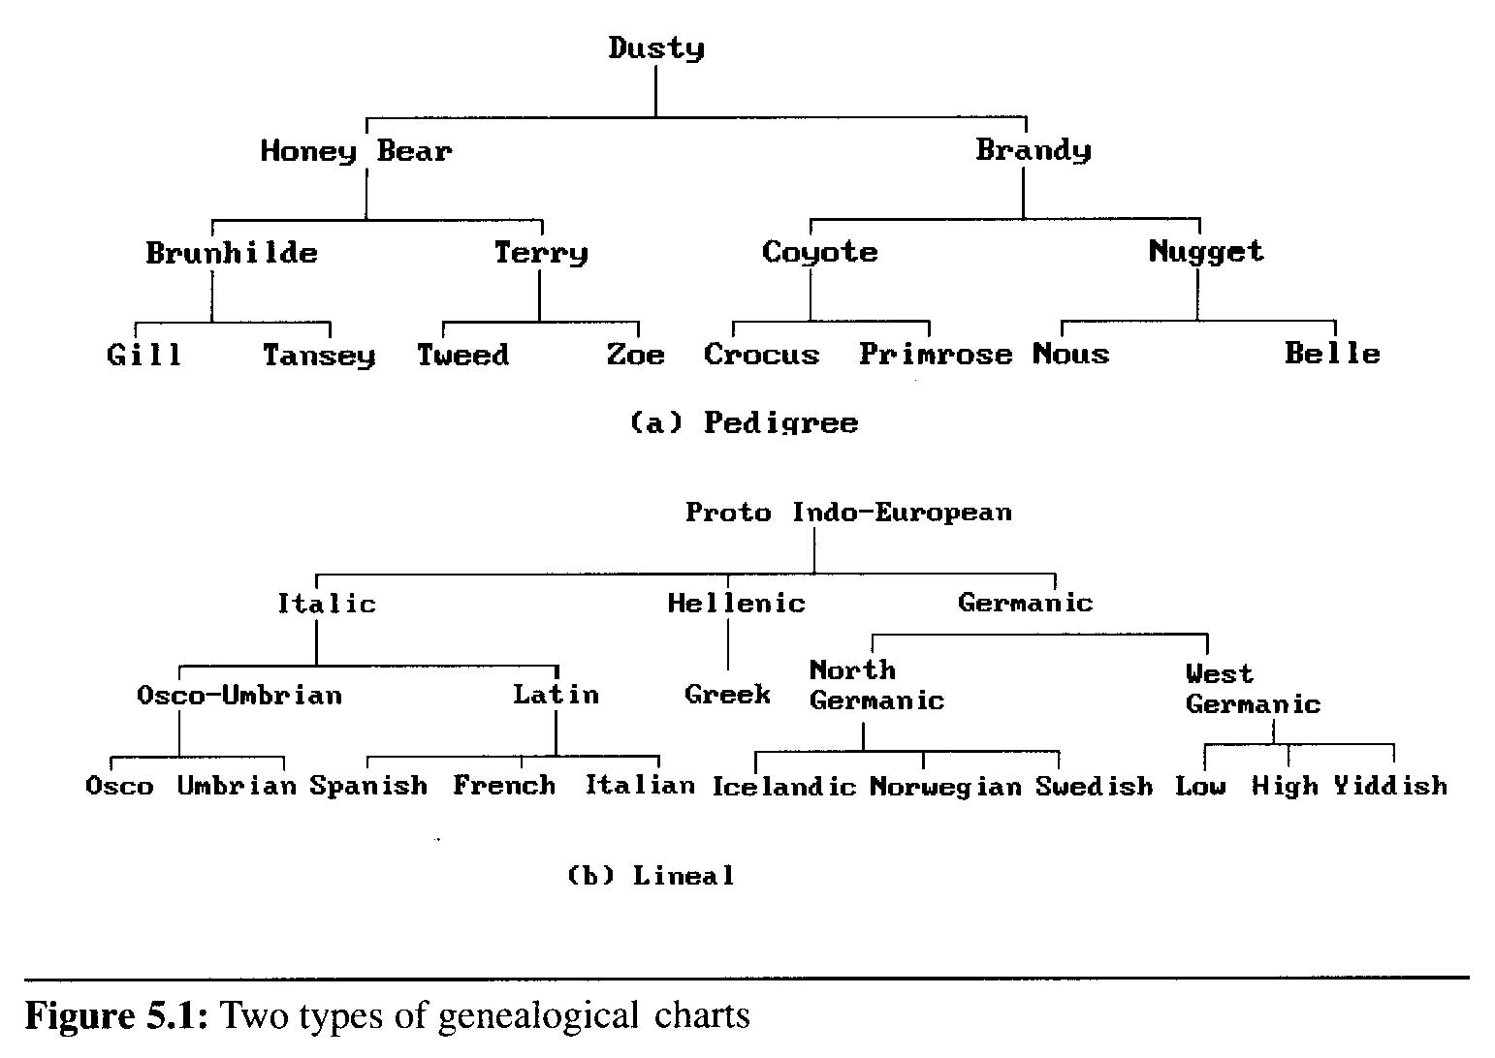
Introduction
A tree structure means that the data are organized so that items of information are related by branches
Examples:

Slide 5

Tree Terminology
• Just like Linked Lists, Trees are
• Conceptualize trees upside down (like
• node: the item of information plus the branches to each node.
collections of nodes
family trees)

Slide 6
Tree Terminology
the top node is the root
• ^{nodes are connected by edges}
• edges define parent and child nodes
• nodes with no children are called external nodes or leaves
^{Nodes with} children are called internal nodes.

Slide 7
More Tree
Terminology
• Nodes that share the
• A path is a sequence of nodes such that the next node in the sequence is a child of the previous
same parent are siblings

Slide 8
More Tree
Terminology
length of the path from root
• the height of a tree is
• if a path exists between
ancestor and the other is a descendant
•
a nodeʼs depth is the
the maximum depth
two nodes, one is an

Slide 9
Subtrees
A subtree is a part of a tree that is a tree in itself
root
A
B
C
I
K
D
E
F
J
G
H
subtree

Slide 10
Subtrees (cont.)
It normally includes each node reachable from its root.
root
A
B
C
I
K
D
E
F
J
G
H
subtree

Slide 11
Subtrees (cont.)
G and H are reachable from the root.
root
A
B
C
I
K
D
E
F
J
G
H

Slide 12
Subtrees (cont.)
So, normally, G and H would be a part of the subtree.
root
A
B
C
I
K
D
E
F
J
G
H

Slide 13
Other terminology
Some Terminology
node: the item of information plus the branches to each node.
degree: the number of subtrees of a node
degree of a tree: the maximum of the degree of the nodes in the tree.
terminal nodes (or leaf): nodes that have degree zero
nonterminal nodes: nodes that don’t belong to terminal nodes.
children: the roots of the subtrees of a node X are the children of X
parent: X is the parent of its children.

Slide 14
Some Terminology (cont’d)
siblings: children of the same parent are said to be siblings.
Ancestors of a node: all the nodes along the path from the root to that node.
The level of a node: defined by letting the root be at level one. If a node is at level l, then it children are at level l+1.
Height (or depth): the maximum level of any node in the tree

Slide 15
Example
Example
A is the root node
B is the parent of D and E
C is the sibling of B
D and E are the children of B
D, E, F, G, I are external nodes, or leaves
A, B, C, H are internal nodes
The level (depth) of E is 3
The height of the tree is 4
The degree of node B is 2
The degree of the tree is 3
The ancestors of node I is A, C, H
The descendants of node C is F, G, H, I
Property: (# edges) = (#nodes) - 1
Level
A
1
B
C
2
H
3
D
E
F
G
I
4

Slide 16
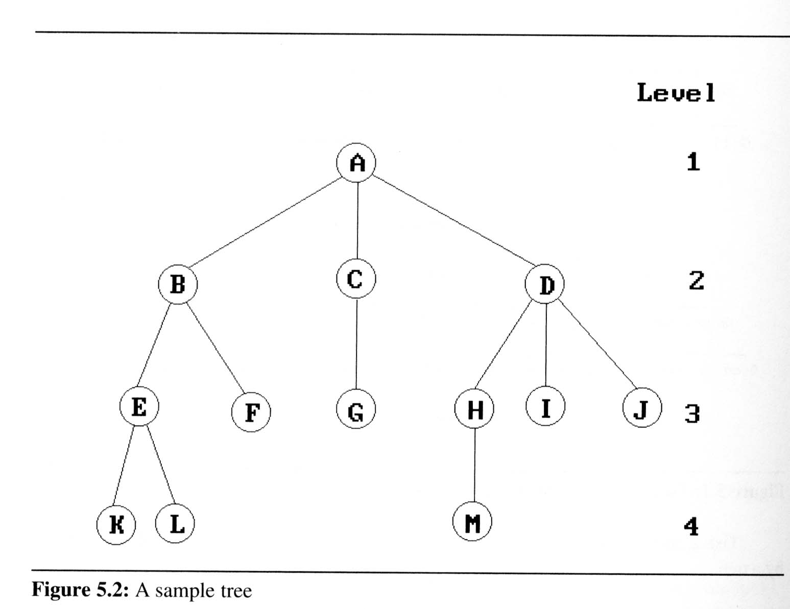
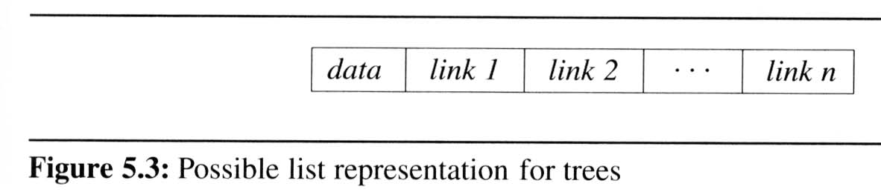
Representation Of Trees
List Representation
we can write of Figure 5.2 as a list in which each of the subtrees is also a list
( A ( B ( E ( K, L ), F ), C ( G ), D ( H ( M ), I, J ) ) )
The root comes first, followed by a list of sub-trees

Slide 17

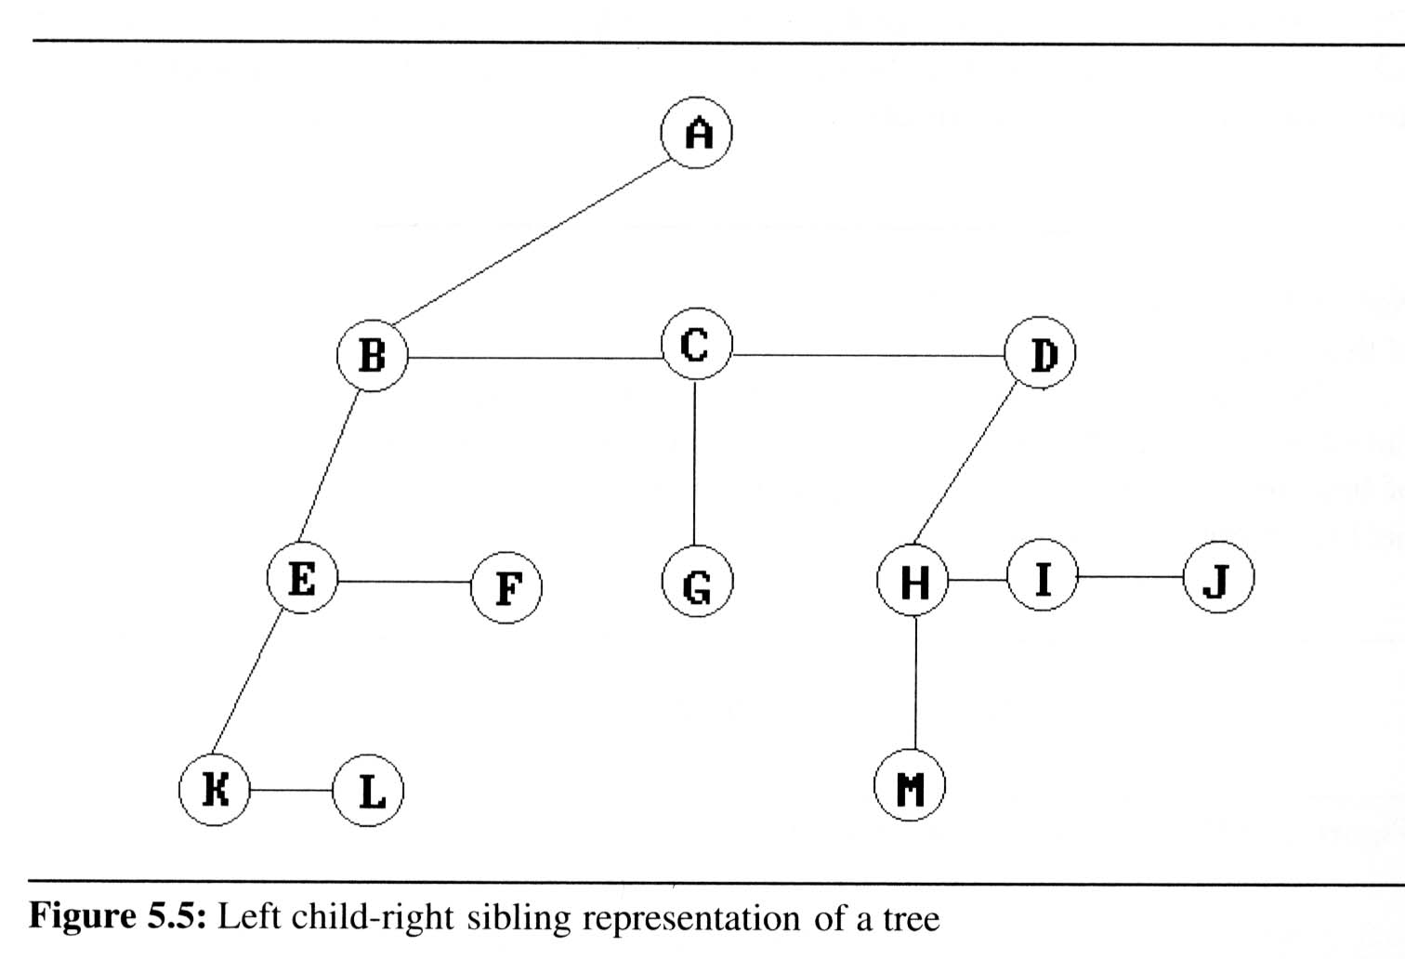
Representation Of Trees
Left Child- Right Sibling Representation

Slide 18
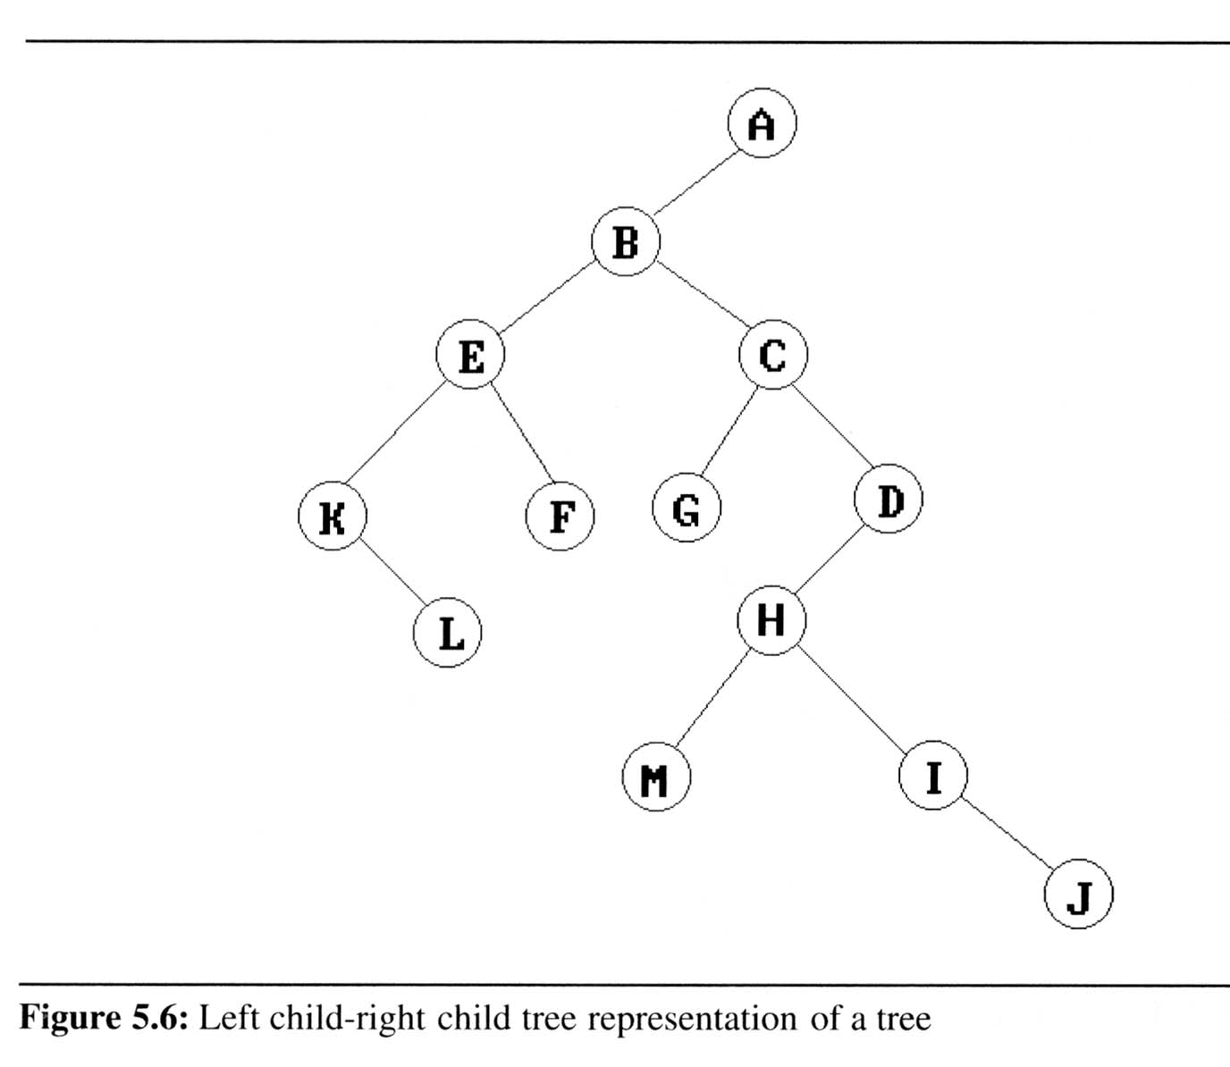
Representation Of Trees
Representation As A Degree Two Tree

Slide 19
Implementation Tree
Definition (recursively): A tree is a finite set of one or more nodes such that
There is a specially designated node called root.
The remaining nodes are partitioned into n>=0 disjoint set T₁,…,T_{n}, where each of these sets is a tree. T₁,…,T_{n} are called the subtrees of the root.
Every node in the tree is the root of some subtree

Slide 20
Tree
○○ We use positions to define the tree
○○ The positions in a tree are its nodes and neighboring positions satisfy the parent-child relationships
method description
root() Return the tree’s root; error if tree is empty
parent(v) Return v’s parent; error if v is a root
children(v) Return v’s children (an iterable collection of nodes)
isRoot(v) Test whether v is a root
isExternal(v) Test whether v is an external node
isInternal(v) Test whether v is an internal node

Slide 21
Tree
method description
isEmpty() Test whether the tree has any node or not
size() Return the number of nodes in the tree
iterator() Return an iterator of all the elements stored in the tree
positions() Return an iterable collection of all the nodes of the tree
replace(v,e) Replace with e and return the element stored at node v

Slide 22

A Linked Structure for Tree
○○ A node is represented by an object storing
○○ Element
○○ A parent node
○○ A sequence of children nodes
(parent node)
(a list of children)
(element)
(child node)

Slide 23
A Linked Structure for
Tree
∅
B
B
∅
∅
A
D
F
A
D
F
C
E
∅
∅
C
E

Slide 24
Tree Traversals
• Suppose we want to print all nodes in a tree
• What order should we visit the nodes?
• Preorder - read the parent before its children
• Postorder - read the parent after its children

Slide 25
Preorder vs.
Postorder
• // parent before children • // parent after children
print(x) for child : myChildren
for child : myChildren postorder(child)
preorder(child) print(x)
preorder(node x)
postorder(node x)

Slide 26


Examples
▪ Tree associate d w ith a docu m ent
Book
Title Abstract Ch1 Ch2 Ch3 Refs
1.1 1.2 3.1 3.2
▪ In w hat order do yo u rea d the docu m ent?
16

Slide 27

Example
▪ Tree associate d w ith an ar ithm etical expre ssio n
+
3 *
- +
12 5 1 7
▪ Wr ite m etho d that evaluate s the expre ssio n. In w hat order do yo u traverse the tree?
17

